Slide 1
Construction Dewatering
CE 544 – BRIGHAM YOUNG UNIVERSITY

Slide 2
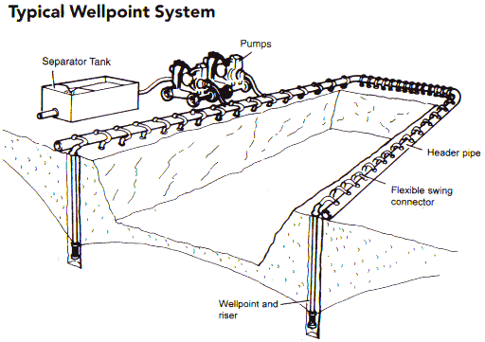
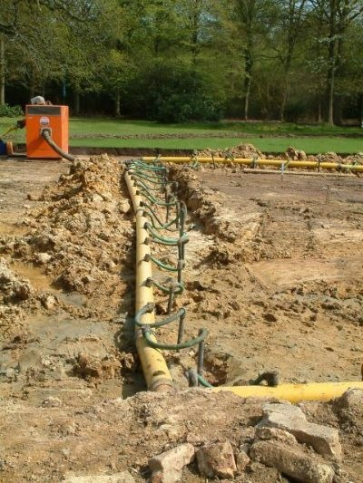
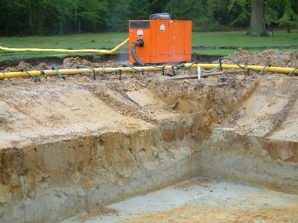
Wellpoint Sytems

Slide 3
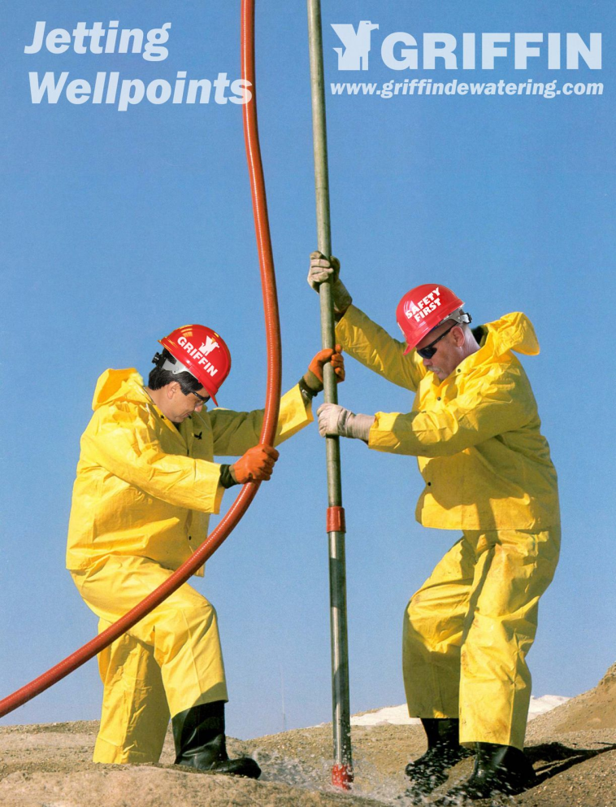
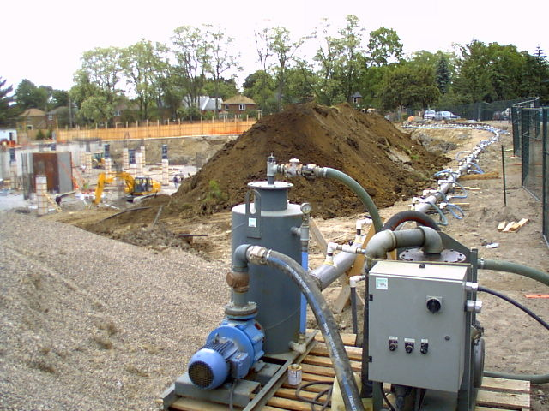
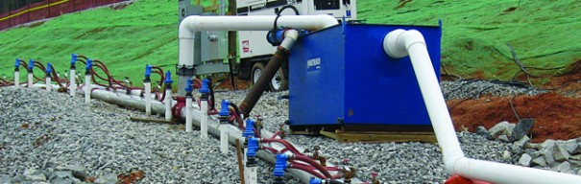
Wellpoint Sytems

Slide 4
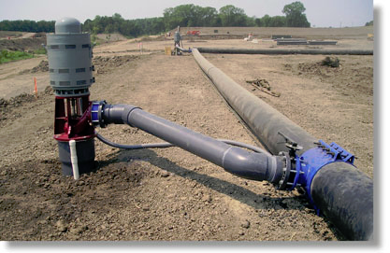
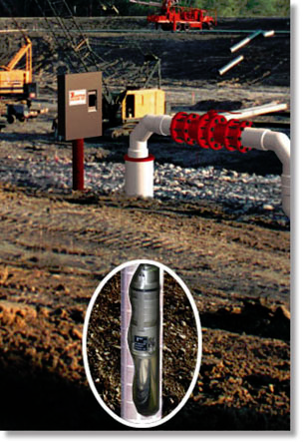
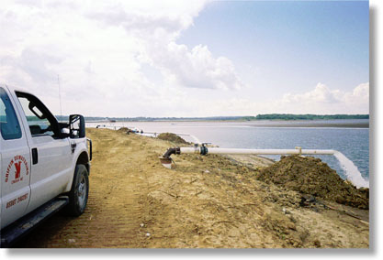
Deep Well Systems

Slide 5
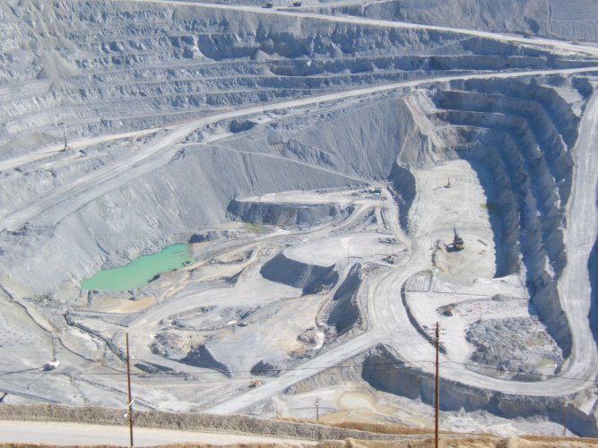
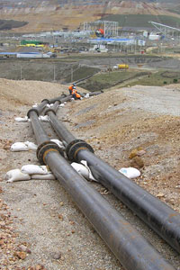
Mine Dewatering

Slide 6
Design
Questions
What pumping rate will be required?
How many wells?
Where will the wells be located?
Use a french drain/trench?
Analytical solutions are often used
Numerical models (MODFLOW, etc.) can be used for more accuracy

Slide 7
Flow to a Trench - Unconfined

Slide 8
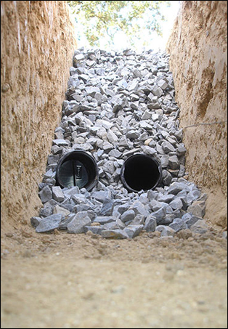
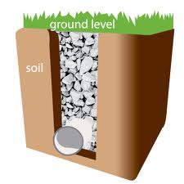
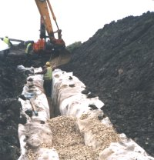
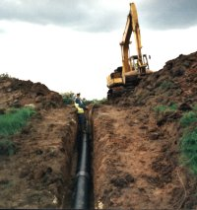
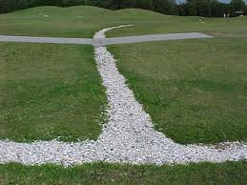
French Drains

Slide 9
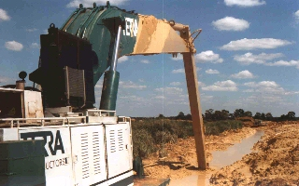
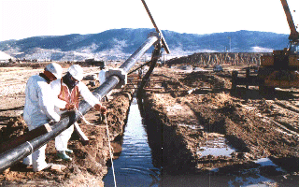
Bio-Polymer (BP) Slurry Trench
Drilling fluid is guar gum or zantham gum
Biodegrades after a few weeks

Slide 10
Wells in Unconfined Soils

Slide 11
Multi-well Systems
Superposition

Slide 12
Caution
Recall that the derivation of the unconfined aquifer well equation relies on the Dupuit assumption that the exit point coincides with the tailwater:
This results in an unconservative estimate of drawdown. This error is greater the closer the water table gets to the bottom of the aquifer. Thus, you should not use this method if the aquifer is close to being dewatered. Use a numerical model instead.
Notes:
Source: Powers, Et al., pp 69.

